Slide 1
UNIT–I
Data Warehousing and Online Analytical Processing: Basic concepts, Data Warehouse Modelling: Data Cube and OLAP, Data Warehouse Design and Usage, Data Warehouse Implementation, Cloud Data Warehouse.
Data Mining and Patten Mining, Technologies, Applications, Major issues.
Data Objects & Attribute Types, Basic Statistical Descriptions of Data, Data Visualization, Measuring Data Similarity and Dissimilarity.

Slide 2
Data Objects and Attribute Types
Data sets are made up of data objects. A data object represents an entity:
In a sales database, the objects may be customers, store items, and sales;
In a medical database, the objects may be patients;
In a university database, the objects may be students, professors, and courses.
Data objects are typically described by attributes. Data objects can also be referred to as samples, examples, instances, data points, or objects.
If the data objects are stored in a database, they are data tuples. That is, the rows of a database correspond to the data objects, and the columns correspond to the attributes.

Slide 3
Attribute:
An attribute is a data field, representing a characteristic or feature of a data object.
The term dimension is commonly used in data warehousing.
Machine learning literature tends to use the term feature, while statisticians prefer the term variable.
Data mining and database professionals commonly use the term attribute.
Attributes describing a customer object can include, for example, customer ID, name, and address.
The type of an attribute is determined by the set of possible values:
nominal, binary, ordinal, or numeric

Slide 4
Nominal Attributes:
Nominal means “relating to names.” The values of a nominal attribute are symbols or names of things. The values do not have any meaningful order.
Ex: Hair color: {Block, Brown, grey, Red}, Marital status and Occupation.
Binary Attributes:
A binary attribute is a nominal attribute with only two categories or states: 0 or 1, where 0 means absent, and 1 means it is present.
Binary attributes are referred to as Boolean if the two states correspond to true and false..
Symmetric Binary: Both outcomes equally important. Ex: gender
Asymmetric Binary: Outcomes not equally important.
Ex: Medical Test (Positive vs. Negative)
Conversion: Assign 1 to most important outcome
Ordinal Attributes:
An ordinal attribute is an attribute with possible values that have a meaningful order or ranking among them.
Ex: Examples: rankings (e.g., taste of potato chips on a scale from 1-10), grades, height {tall, medium, short}.

Slide 5
Numeric Attributes:
A numeric attribute is quantitative; that is, it is a measurable quantity, represented in integer or real values.
Numeric attributes can be: Interval-scaled or Ratio-scaled.
Interval-Scaled Attributes:
Measured on a scale of equal-size units.
Values have order and can be positive, 0, or negative.
Thus, in addition to providing a ranking of values, such attributes allow us to compare and quantify the difference between values.
Ex: A temperature in C* or F* and calendar dates (interval-scaled)
(i) A temperature of 20C is five degrees higher than a temperature of 15C.
(ii) The years 2002 and 2010 are eight years apart.

Slide 6
Ratio-Scaled Attributes:
A ratio-scaled attribute is a numeric attribute with an inherent zero-point. That is, if a measurement is ratio-scaled, we can speak of a value as being a multiple (or ratio) of another value. In addition, the values are ordered, and we can also compute the difference between values, as well as the mean, median, and mode.
Ex: (i) Unlike temperatures in Celsius and Fahrenheit, the Kelvin (K) temperature scale has what is considered a true zero-point (0K 273.15C).
(ii) Count attributes such as years of experience (e.g., the objects are employees) and number of words (e.g., the objects are documents).
(iii) Weight, Height, Latitude and longitude coordinates (e.g., when clustering houses), and monetary quantities (e.g., you are 100 times richer with $100 than with $1).

Slide 7
Discrete and Continuous Attributes:
Discrete Attribute:
Has only a finite or countably infinite set of values
Examples: zip codes, counts, or the set of words in a collection of documents
Often represented as integer variables.
Note: binary attributes are a special case of discrete attributes
Continuous Attribute:
Has real numbers as attribute values
Examples: temperature, height, or weight.
Practically, real values can only be measured and represented using a finite number of digits.
Continuous attributes are typically represented as floating-point variables.

Slide 8
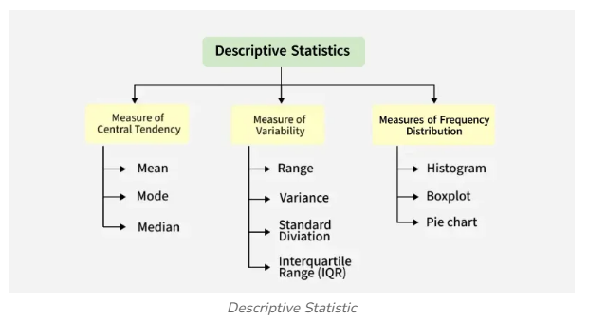
Basic Statistical Descriptions of Data

Slide 9
Basic Statistical Descriptions of Data
Basic statistical descriptions can be used to identify properties of the data and highlight which data values should be treated as noise or outliers.
i) Measures of central tendency, which measure the location of the middle or center of a data distribution.
Ex: mean, median, mode, and midrange.
ii) Dispersion of the data: That is, how are the data spread out.
Ex: range, quartiles, and interquartile range; the five-number summary and boxplots; and the variance and standard deviation of the data.
iii) Graphic displays of basic statistical descriptions to visually inspect our data. Ex: bar charts, pie charts, and line graphs.
Note: Other popular displays of data summaries and distributions include quantile plots, quantile – quantile plots, histograms, and scatter plots.

Slide 10
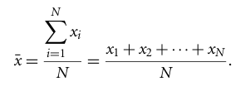
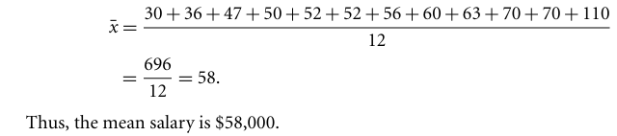
Measuring the Central Tendency: Mean, Median and Mode
Let x1, x2, ..,xN be the set of N observations for X. Here, these values may also be referred to as the data set (for X). If we were to plot the observations for salary, where would most of the values fall? This gives us an idea of the central tendency of the data.
Mean:
Suppose we have the following values for salary (in thousands of dollars), shown in increasing order: 30, 36, 47, 50, 52, 52, 56, 60, 63, 70,70, 110. Using above Eq. we have:

Slide 11
Median: which is the middle value in a set of ordered data values. It is the value that separates the higher half of a data set from the lower half.
Ex: From the previous example, There is an even number of observations (i.e., 12); therefore, the median is not unique. It can be any value within the two middlemost values of 52 and 56. By convention, we assign the average of the two middlemost values as the median;
that is, (52+56)/2 = 108/2 = 54.
Suppose that we had only the first 11 values in the list. Given an odd number of values, the median is the middlemost value. That is: 52

Slide 12
Mode: The mode for a set of data is the value that occurs most frequently in the set.
It is used to identify the most frequently occurring value in a dataset
Data sets with one, two, or three modes are respectively called unimodal, bimodal, and trimodal.
Ex: The data from previous Example are bimodal. The two modes are 52 and 70.
Note: i) A data set with two or more modes is multimodal.
ii) For unimodal numeric data that are moderately skewed (asymmetrical).
iii) The midrange can also be used to assess the central tendency of a numeric data set. It is the average of the largest and smallest values in the set.
Ex: The midrange of the data of previous Example is: (30 +110)= 70

Slide 13
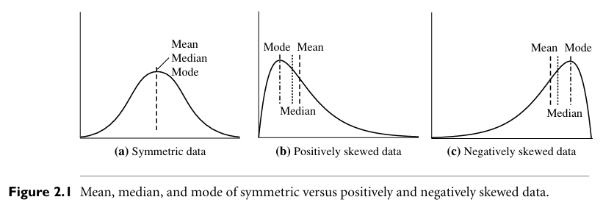
In a unimodal frequency curve with perfect symmetric data distribution, the mean, median, and mode are all at the same center value, as shown in Figure 2.1(a).
Data in most real applications are not symmetric. They may instead be either positively skewed, where the mode occurs at a value that is smaller than the median (Figure 2.1b), or negatively skewed, where the mode occurs at a value greater than the median (Figure 2.1c).

Slide 14


(a) Symmetric Distribution (Normal Distribution)-Mean,median and mode are equal
(b) Positively Skewed Distribution (Right-Skewed)
(c) Negatively Skewed Distribution (Left-Skewed)

Slide 15
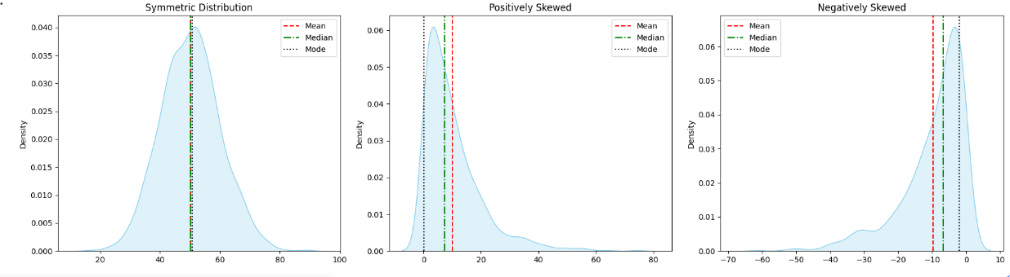

Slide 16
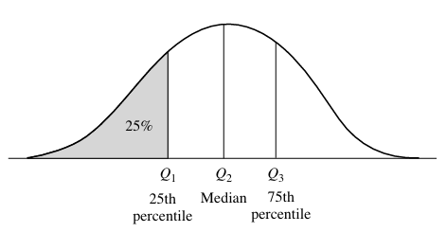
Measuring the Dispersion of Data: Range, Quartiles, Variance, Standard Deviation, and Interquartile Range
Various measures to assess the dispersion or spread of numeric data are: range, quantiles, quartiles, percentiles, and the interquartile range.
The five-number summary, which can be displayed as a boxplot, is useful in identifying outliers. Variance and standard deviation also indicate the spread of a data distribution.
Let x1,x2, ,xN be a set of observations for some numeric attribute, X. The range of the set is the difference between the largest (max()) and
smallest (min()) values.
These data points are
called quantiles. Quantiles
are points taken at regular
intervals of a data
distribution, dividing it
into equal size consecutive
sets.

Slide 17
Five-Number Summary, Boxplots, and Outliers
The five-number summary of a distribution consists of the median (Q2), the quartiles Q1 and Q3, and the smallest and largest individual observations, written in the order of:
Minimum, Q1, Median, Q3, Maximum.
Boxplots are a popular way of visualizing a distribution. It incorporates the five-number summary as follows:
The ends of the box are at the quartiles so that the box length is the interquartile range (IQR).
The median is marked by a line within the box.
Two lines (called whiskers) outside the box extend to the smallest (Minimum) and largest (Maximum) observations.
A common rule for identifying suspected outliers is to single out values falling at least 1.5xIQR above the third quartile or below the first quartile.

Slide 18
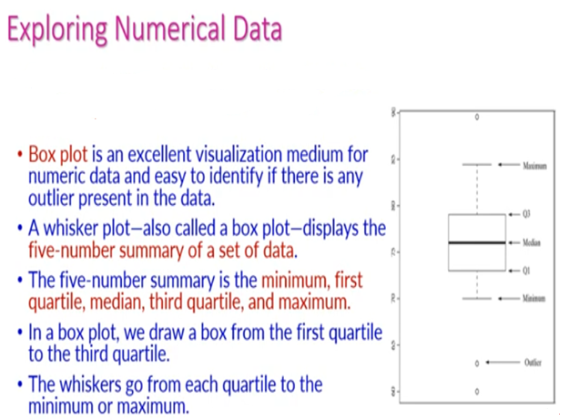

Slide 19
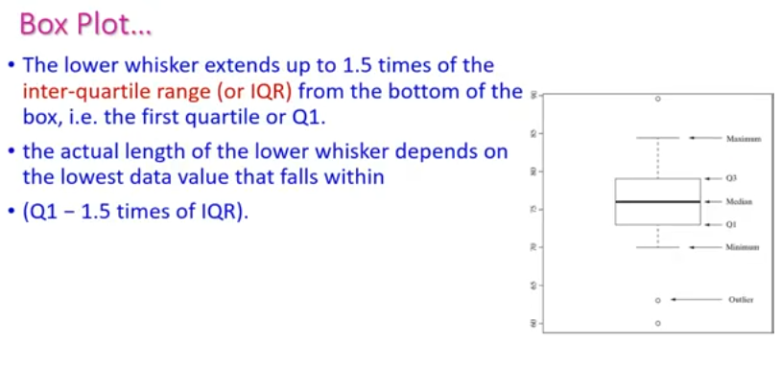
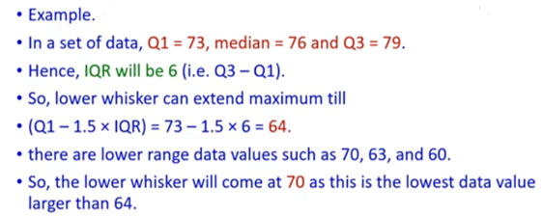

Slide 20
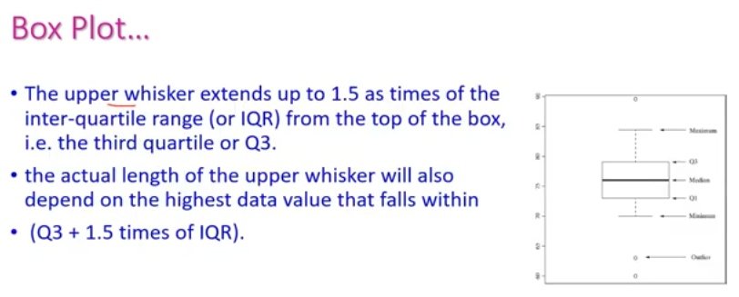
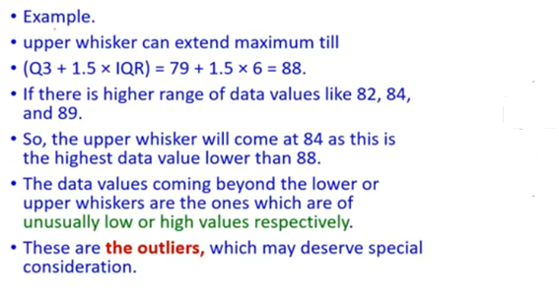

Slide 21
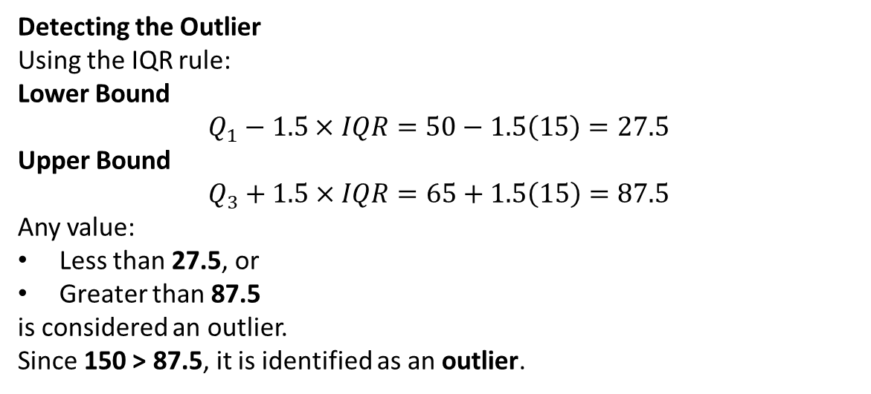
Detecting the Outlier
Using the IQR rule:
Lower Bound
$$Q_{1}−1.5×IQR=50−1.5\left(15\right)=27.5$$
Upper Bound
$$Q_{3}+1.5×IQR=65+1.5\left(15\right)=87.5$$
Any value:
Less than 27.5, or
Greater than 87.5
is considered an outlier.
Since 150 > 87.5, it is identified as an outlier.

Slide 22
import matplotlib.pyplot as plt
# Sample data
data = [10, 12, 14, 15, 18, 21, 22, 24, 27, 30, 45]
# Create box plot
plt.boxplot(data)
# Add title and labels
plt.title("Box Plot Example")
plt.ylabel("Values")
plt.show()

Slide 23
import numpy as np
data = [12, 15, 18, 20, 22, 25, 28, 30, 35]
q1 = np.percentile(data, 25)
q2 = np.percentile(data, 50)
q3 = np.percentile(data, 75)
iqr = q3 - q1
print("Q1 =", q1)
print("Q2 =", q2)
print("Q3 =", q3)
print("IQR =", iqr)

Slide 24
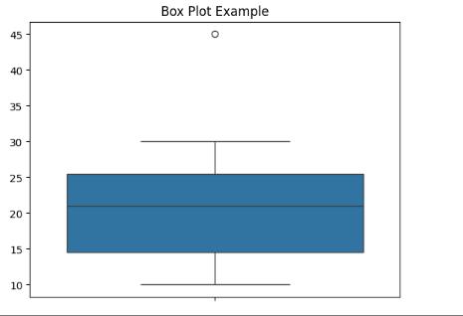

Slide 25
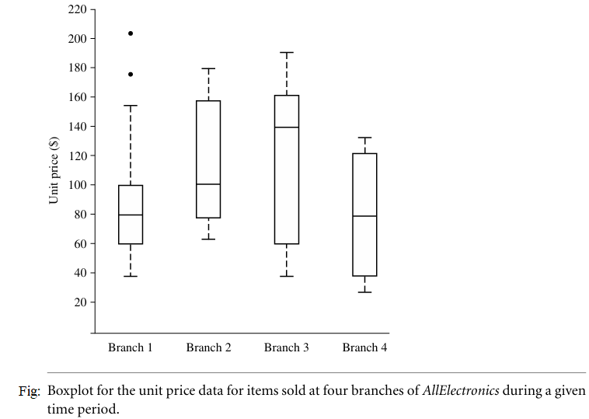

Slide 26
import pandas as pd
import seaborn as sns
import matplotlib.pyplot as plt
# Sample DataFrame
df = pd.DataFrame({
'Age': [20, 22, 25, 24, 26, 23, 21],
'Experience': [1, 2, 3, 2, 4, 2, 3]
})
plt.figure(figsize=(8,5))
sns.boxplot(data=df)
plt.title("Box Plot of Multiple Columns")
plt.show()

Slide 27
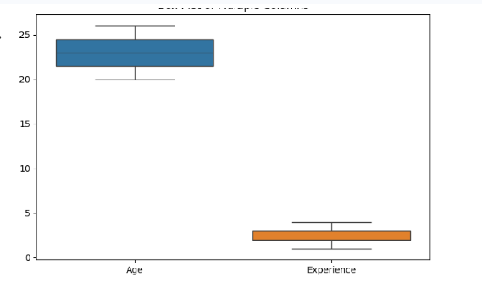

Slide 28
import seaborn as sns
import matplotlib.pyplot as plt
sns.boxplot(y='Age', data=df)
plt.show()

Slide 29
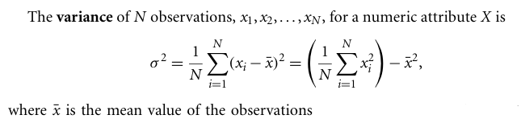
Variance and Standard Deviation
Variance and standard deviation are measures of data dispersion. They indicate how spread out a data distribution is. A low standard deviation means that the data observations tend to be very close to the mean, while a high standard deviation indicates that the data are spread out over a large range of values.

Slide 30
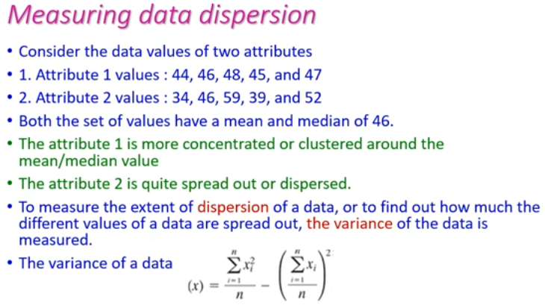

Slide 31
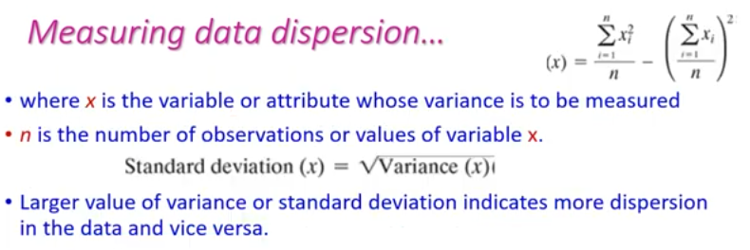
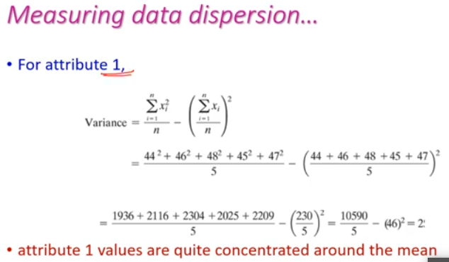

Slide 32
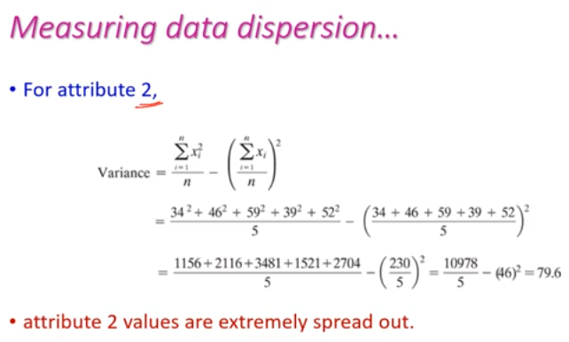

Slide 33
import pandas as pd
df = pd.DataFrame({
'Marks': [2, 4, 6, 8, 10]
})
# Sample Variance (default)
print(df['Marks'].var())
# Population Variance
print(df['Marks'].var(ddof=0))

Slide 34
Graphic Displays of Basic Statistical Descriptions of Data:
These include quantile plots, quantile – quantile plots, histograms, and scatter plots. Such graphs are help full for the visual inspection of data, which is useful for data preprocessing. The first three of these show univariate distributions(i.e., data for one attribute), while scatter plots show bivariate distributions (i.e., involving two attributes).
Quantile Plot:
Quantile - Quantile Plot:

Slide 35
Quantile Plot:

Slide 36
Quantile - Quantile Plot:

Slide 37
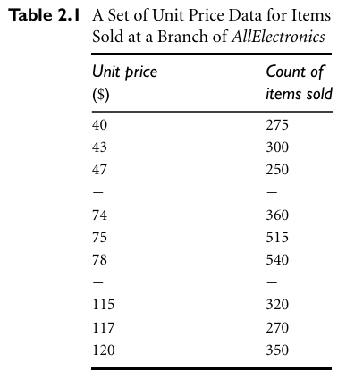

Slide 38
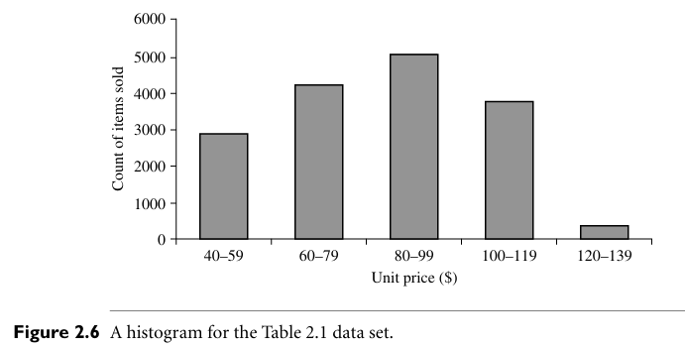
Histograms:

Slide 39
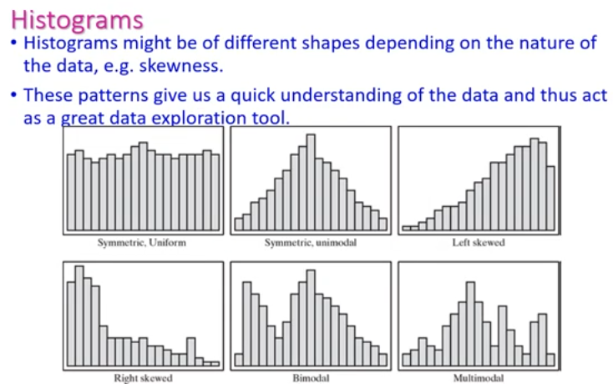

Slide 40
Histogram Analysis:

Slide 41
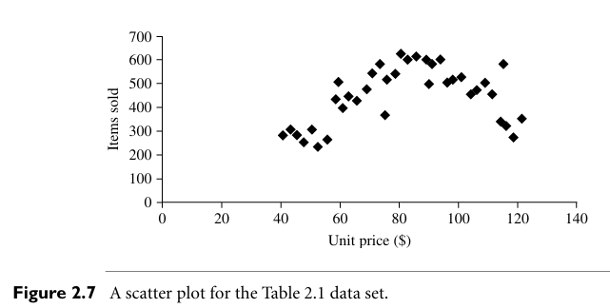
Scatter Plots:

Slide 42
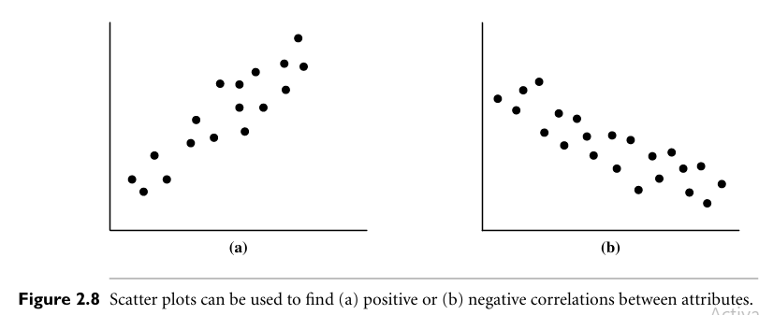
Data Correlation:

Slide 43
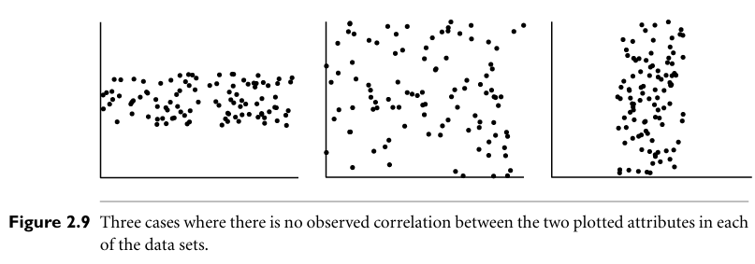

Slide 44
Data Visualization

Slide 45
Pixel-Oriented Visualization Techniques:

Slide 46
Laying out Pixels in Circle Segments:

Slide 47
Geometric Projection Visualization Techniques: Direct Data Visualization:

Slide 48
Scatterplot Matrices: Landscapes:

Slide 49
Parallel Coordinates: Parallel Coordinates of a Dataset

Slide 51
Icon Based Visualization Techniques:

Slide 52
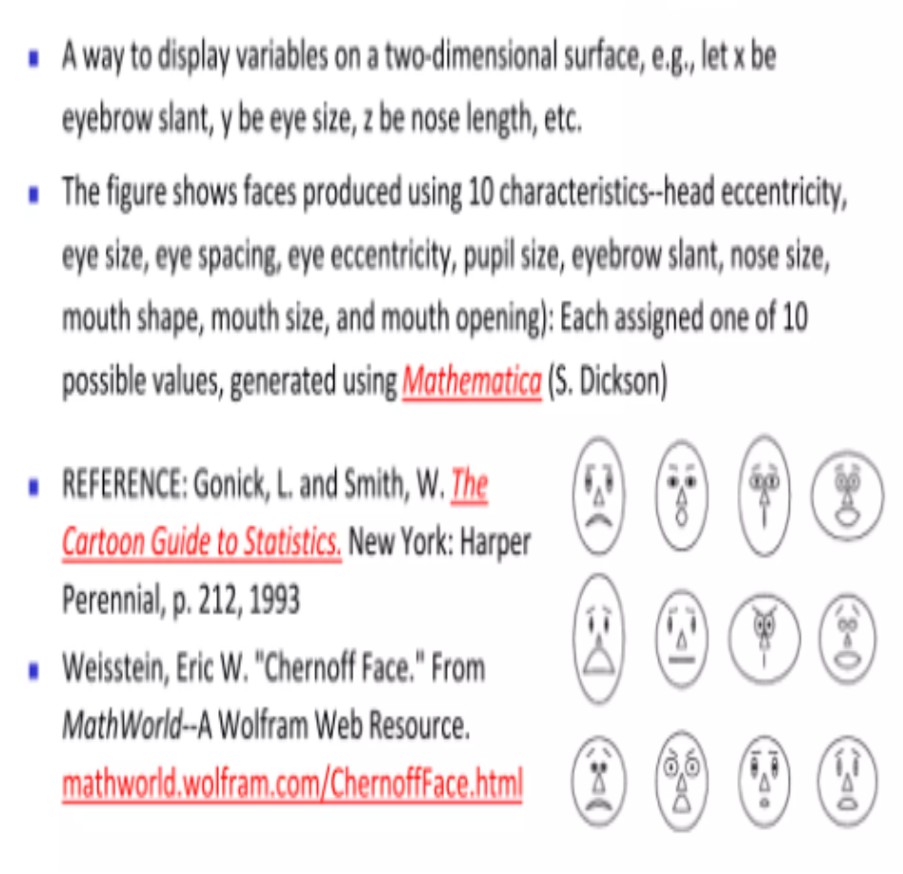
Chernoff Faces:

Slide 53
Stick Figure:

Slide 54
Hierarchical Visualization Techniques:

Slide 55
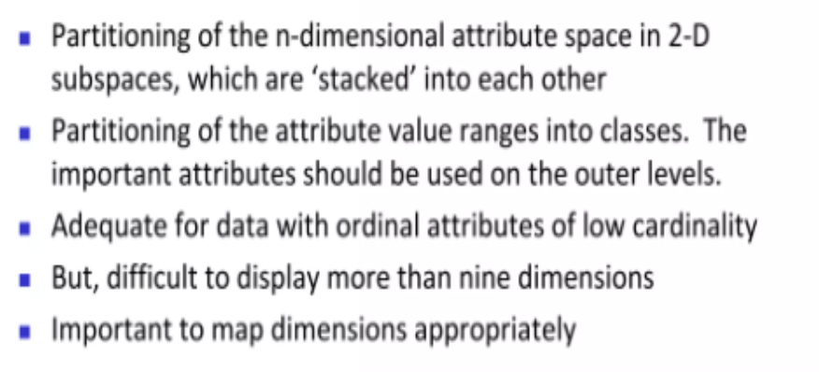
Dimension Stacking:

Slide 56
Worlds-within-worlds: Tree-Map:

Slide 58
InfoCube

Slide 59
Visualizing complex Data and Relations:

